Slide 1
PROBLEM STATEMENT
Houses are one of the necessary needs of each and every person around the globe and therefore housing and real estate market is one of the markets which is one of the major contributors in the world’s economy. It is a very large market and there are various companies working in the domain. Data science comes as a very important tool to solve problems in the domain to help the companies increase their overall revenue, profits, improving their marketing strategies and focusing on changing trends in house sales and purchases. Predictive modelling, Market mix modelling, recommendation systems are some of the machine learning techniques used for achieving the business goals for housing companies. Our problem is related to one such housing company. A US-based housing company named Surprise Housing has decided to enter the Australian market. The company uses data analytics to purchase houses at a price below their actual values and flip them at a higher price. For the same purpose, the company has collected a data set from the sale of houses in Australia. The data is provided in the CSV file below. The company is looking at prospective properties to buy houses to enter the market. You are required to build a model using Machine Learning in order to predict the actual value of the prospective properties and decide whether to invest in them or not.

Slide 2
PROBLEM UNDERSTANDING
As we know real estate market is one of the markets which is one of the major contributions in the world’s economy. There are many companies working in this domain which make this industry very competitive for players. They find very challenging to predict the purchase house at below their actual values and sell them at higher price to gain profit margin. Hence Data Science helps them to predict the prices of house based on various independent variables which plays very important role while predict the price of house. The model helps them to decide whether to invest on the particular properties or not and also helps them to set the correct selling price of the properties based on the properties various attributes. This model will then be used by the management to understand how exactly the prices vary with the variables. They can accordingly manipulate the strategy of the firm and concentrate on areas that will yield high returns. Further, the model will be a good way for the management to understand the pricing dynamics of a new market
For this company wants to know:
• Which variables are important to predict the price of variable?
• How do these variables describe the price of the house?

Slide 3
EDA STEPS ,VISUALIZATIONS,FINALIZED MODEL AND CONCLUSION
Variable identification.
Statistical Summary of Features data.
Graphical Analysis.
Finding Important Features for Model
Dealing with Skewed Target Variable
Principal Components Analysis
Model Development and Evaluation
Checking Overfitting & Underfitting Problem
Conclusion

Slide 4
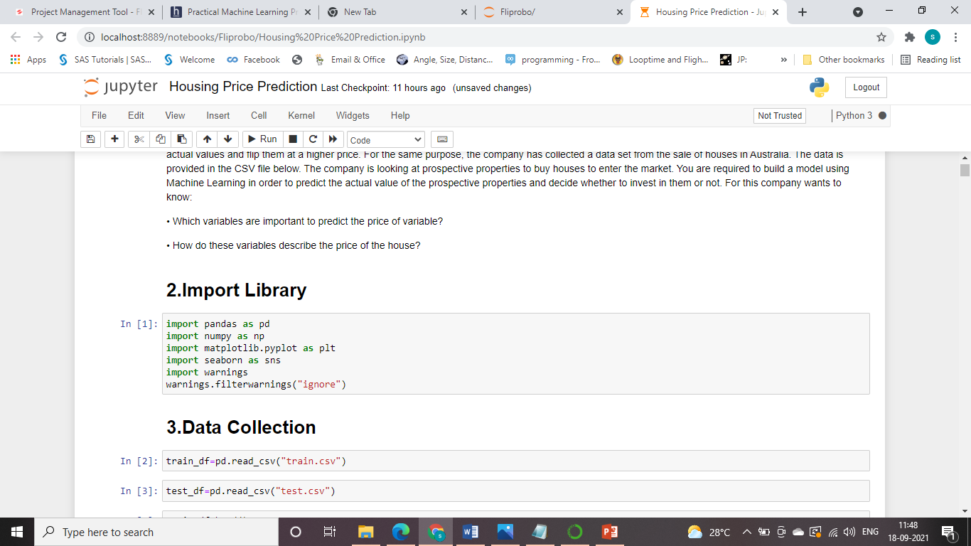
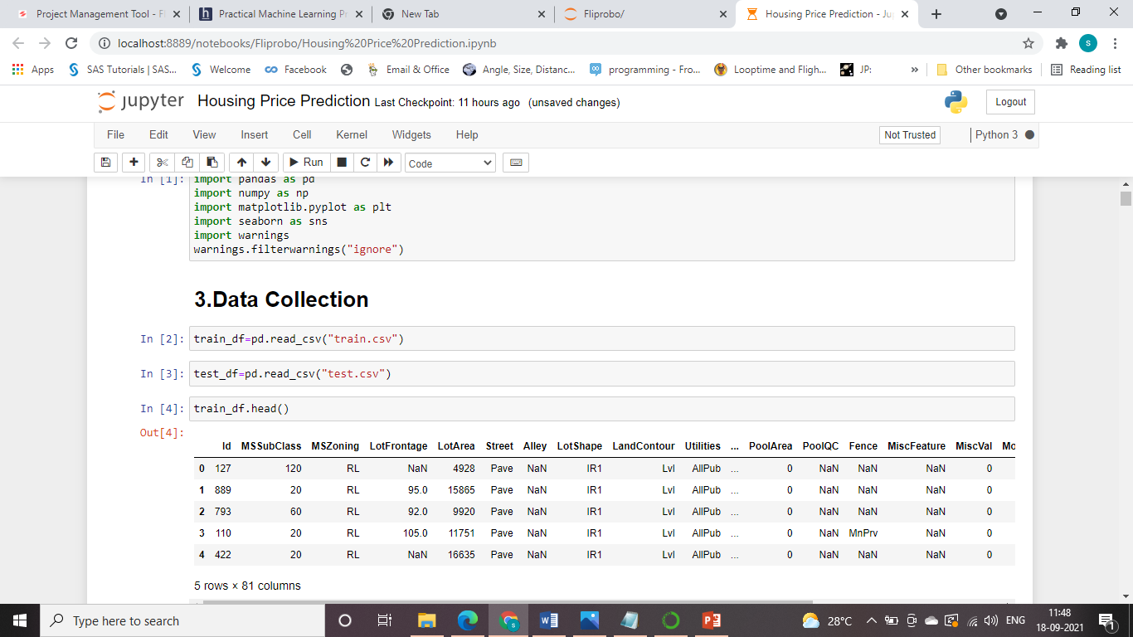
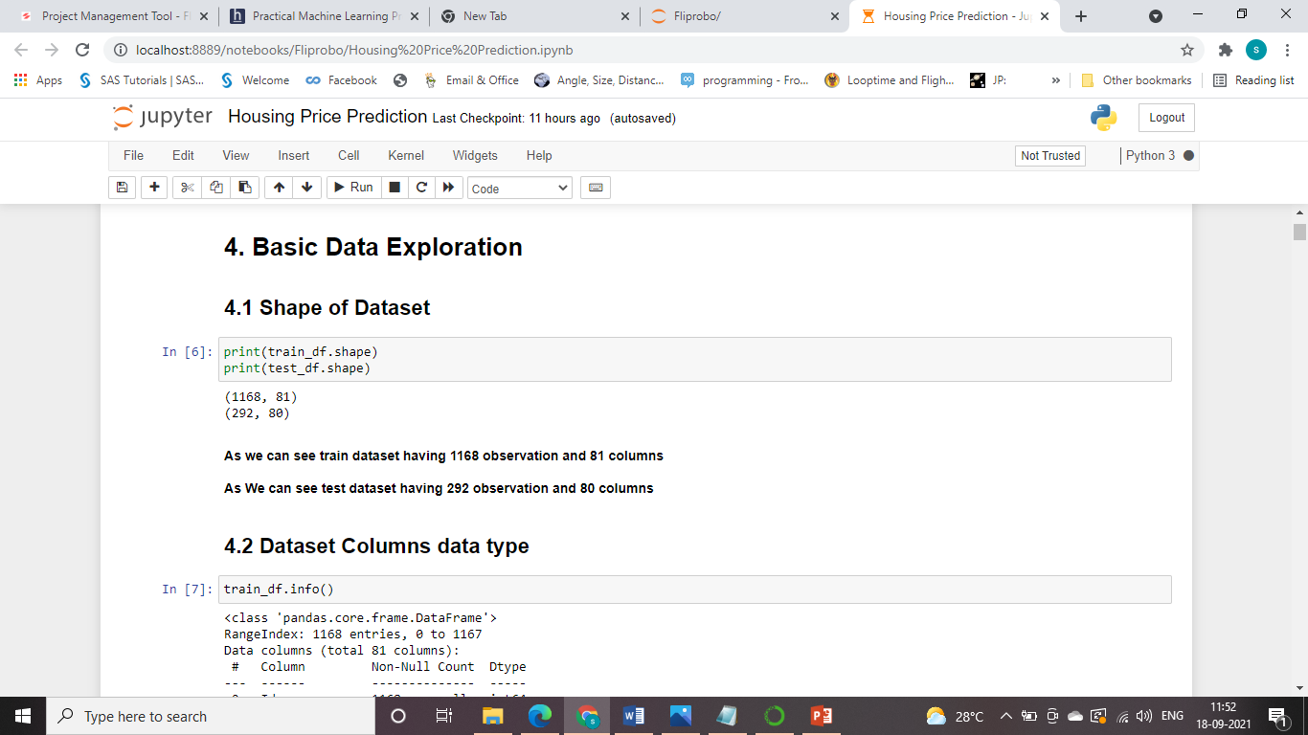
Variable identification.
Importing Libraries:
Importing Dataset:
Size of the dataset:

Slide 5
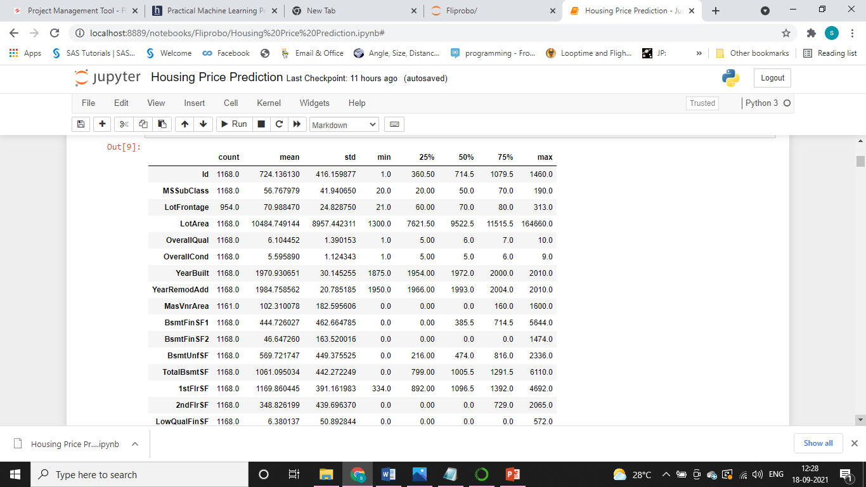
Statistical Summary of Features data.

Slide 6
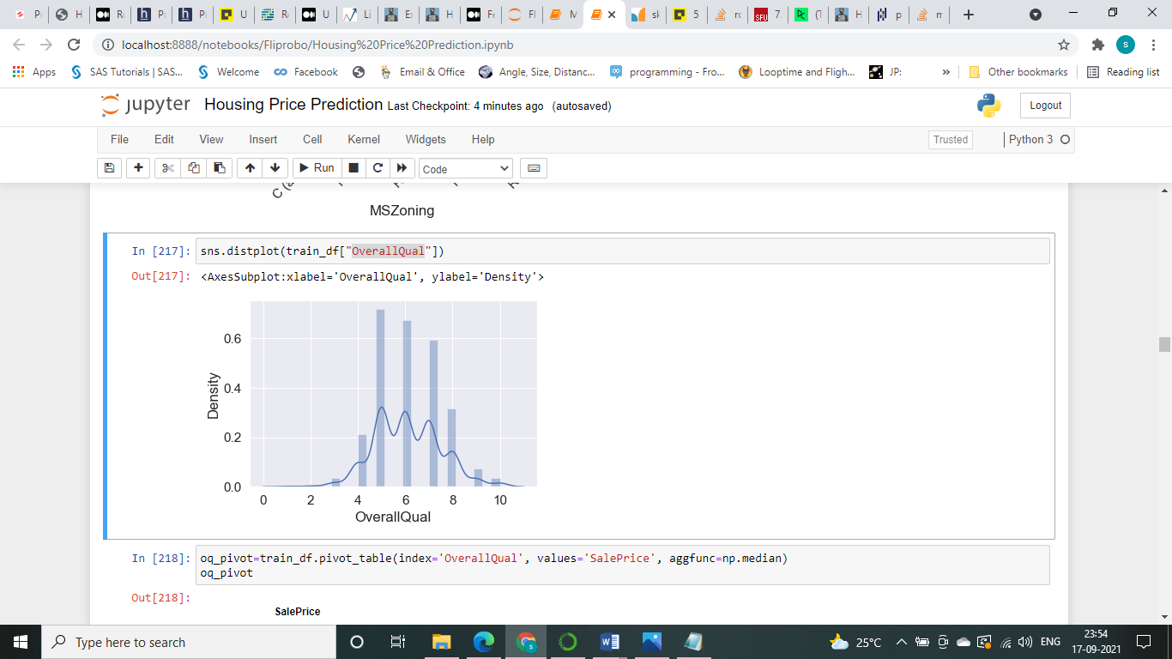
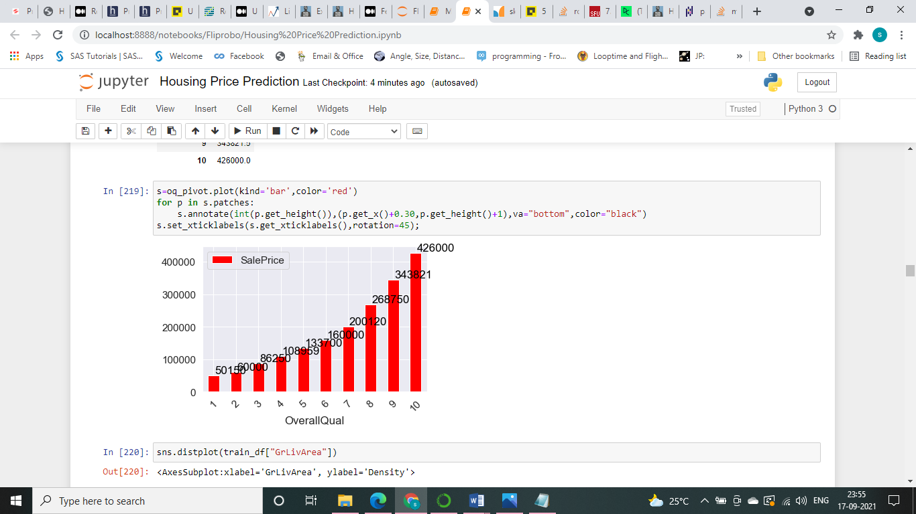
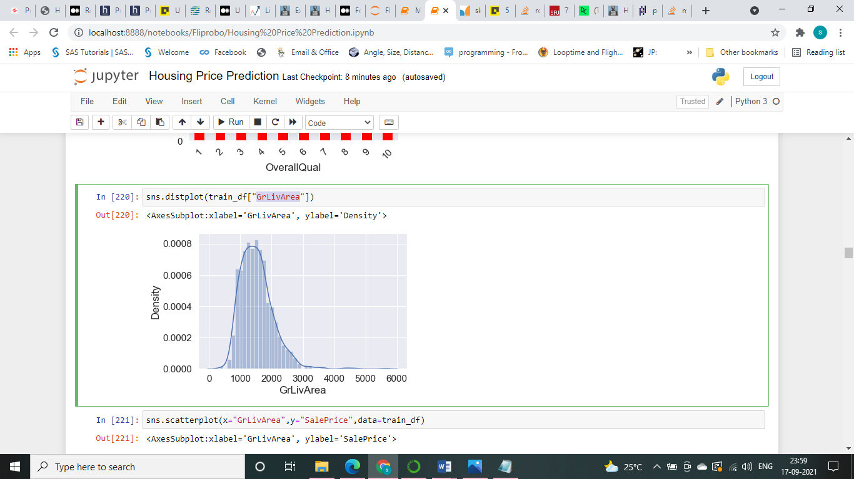
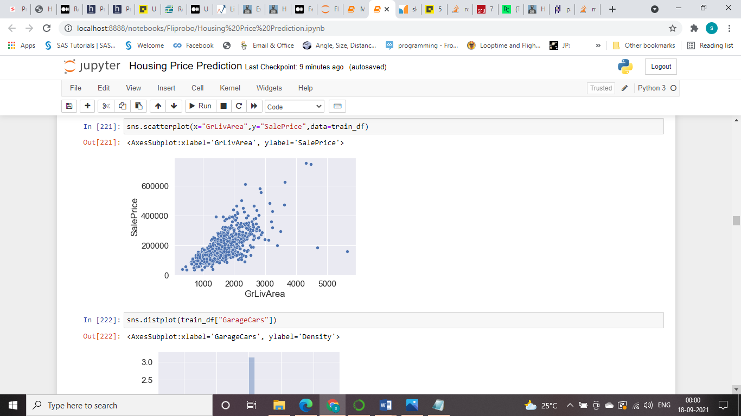
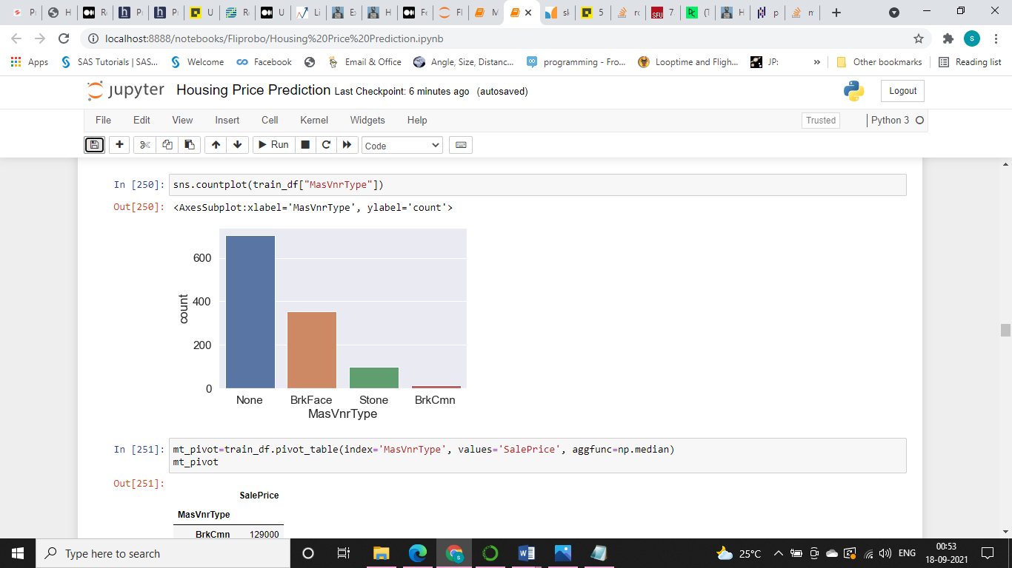
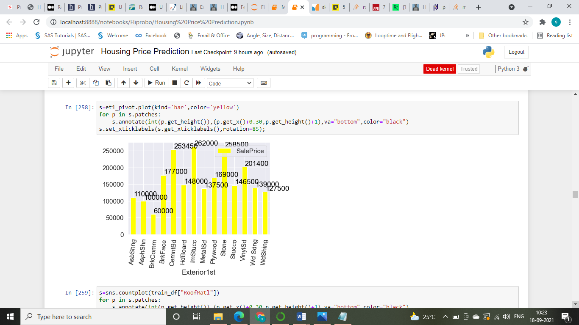
Graphical Analysis.
For analyzing Visually we have applied Univariate Analysis, Bivariate Analysis and Multivariate Analysis through various graph , chart ,plot etc.

Slide 7
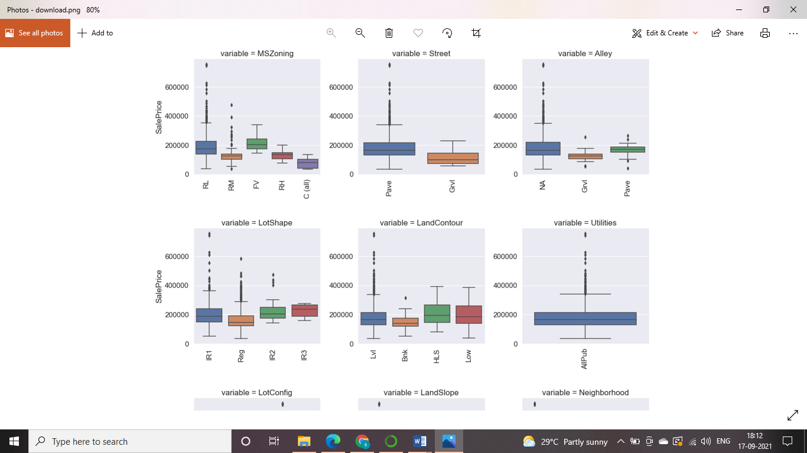
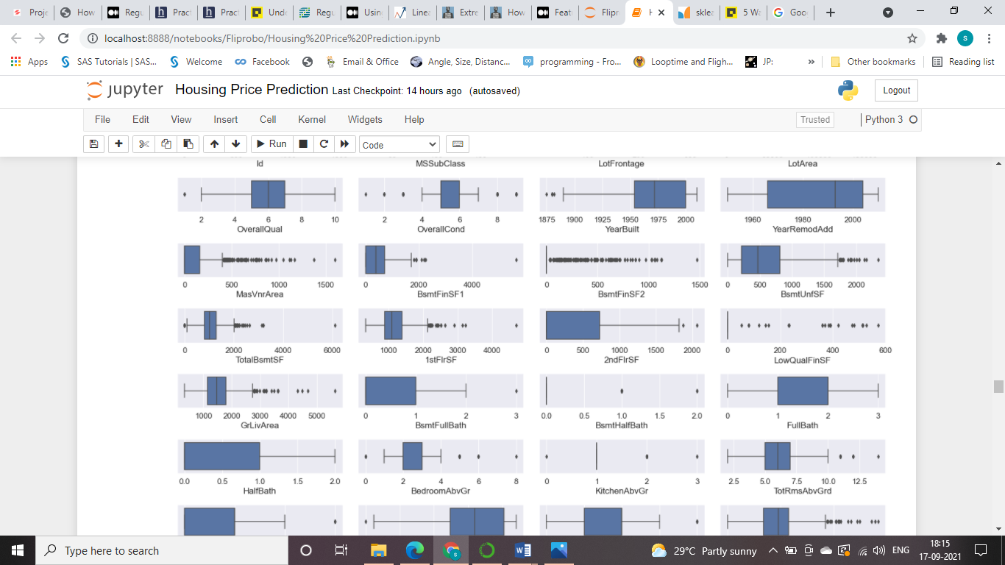
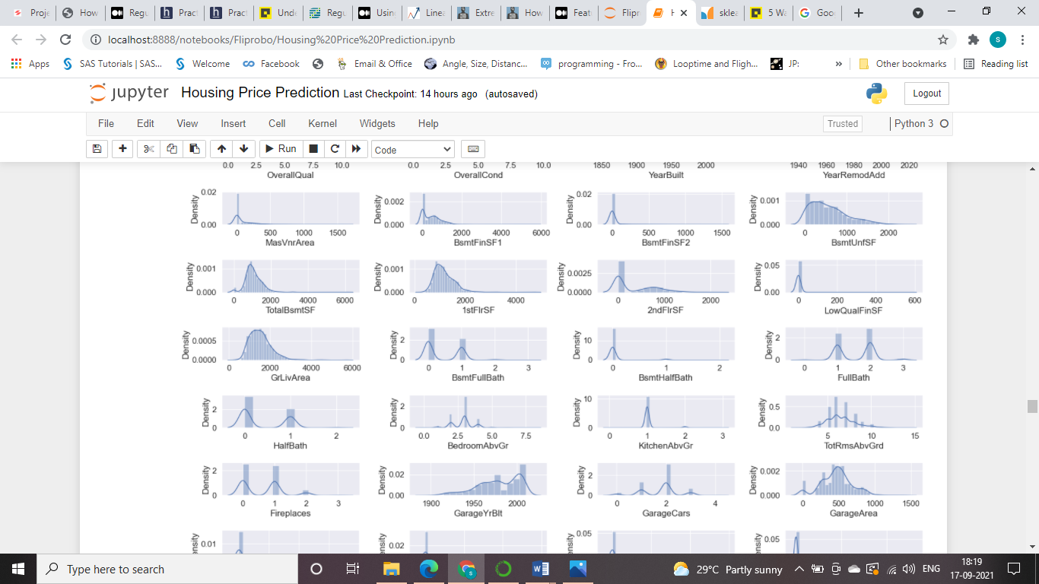
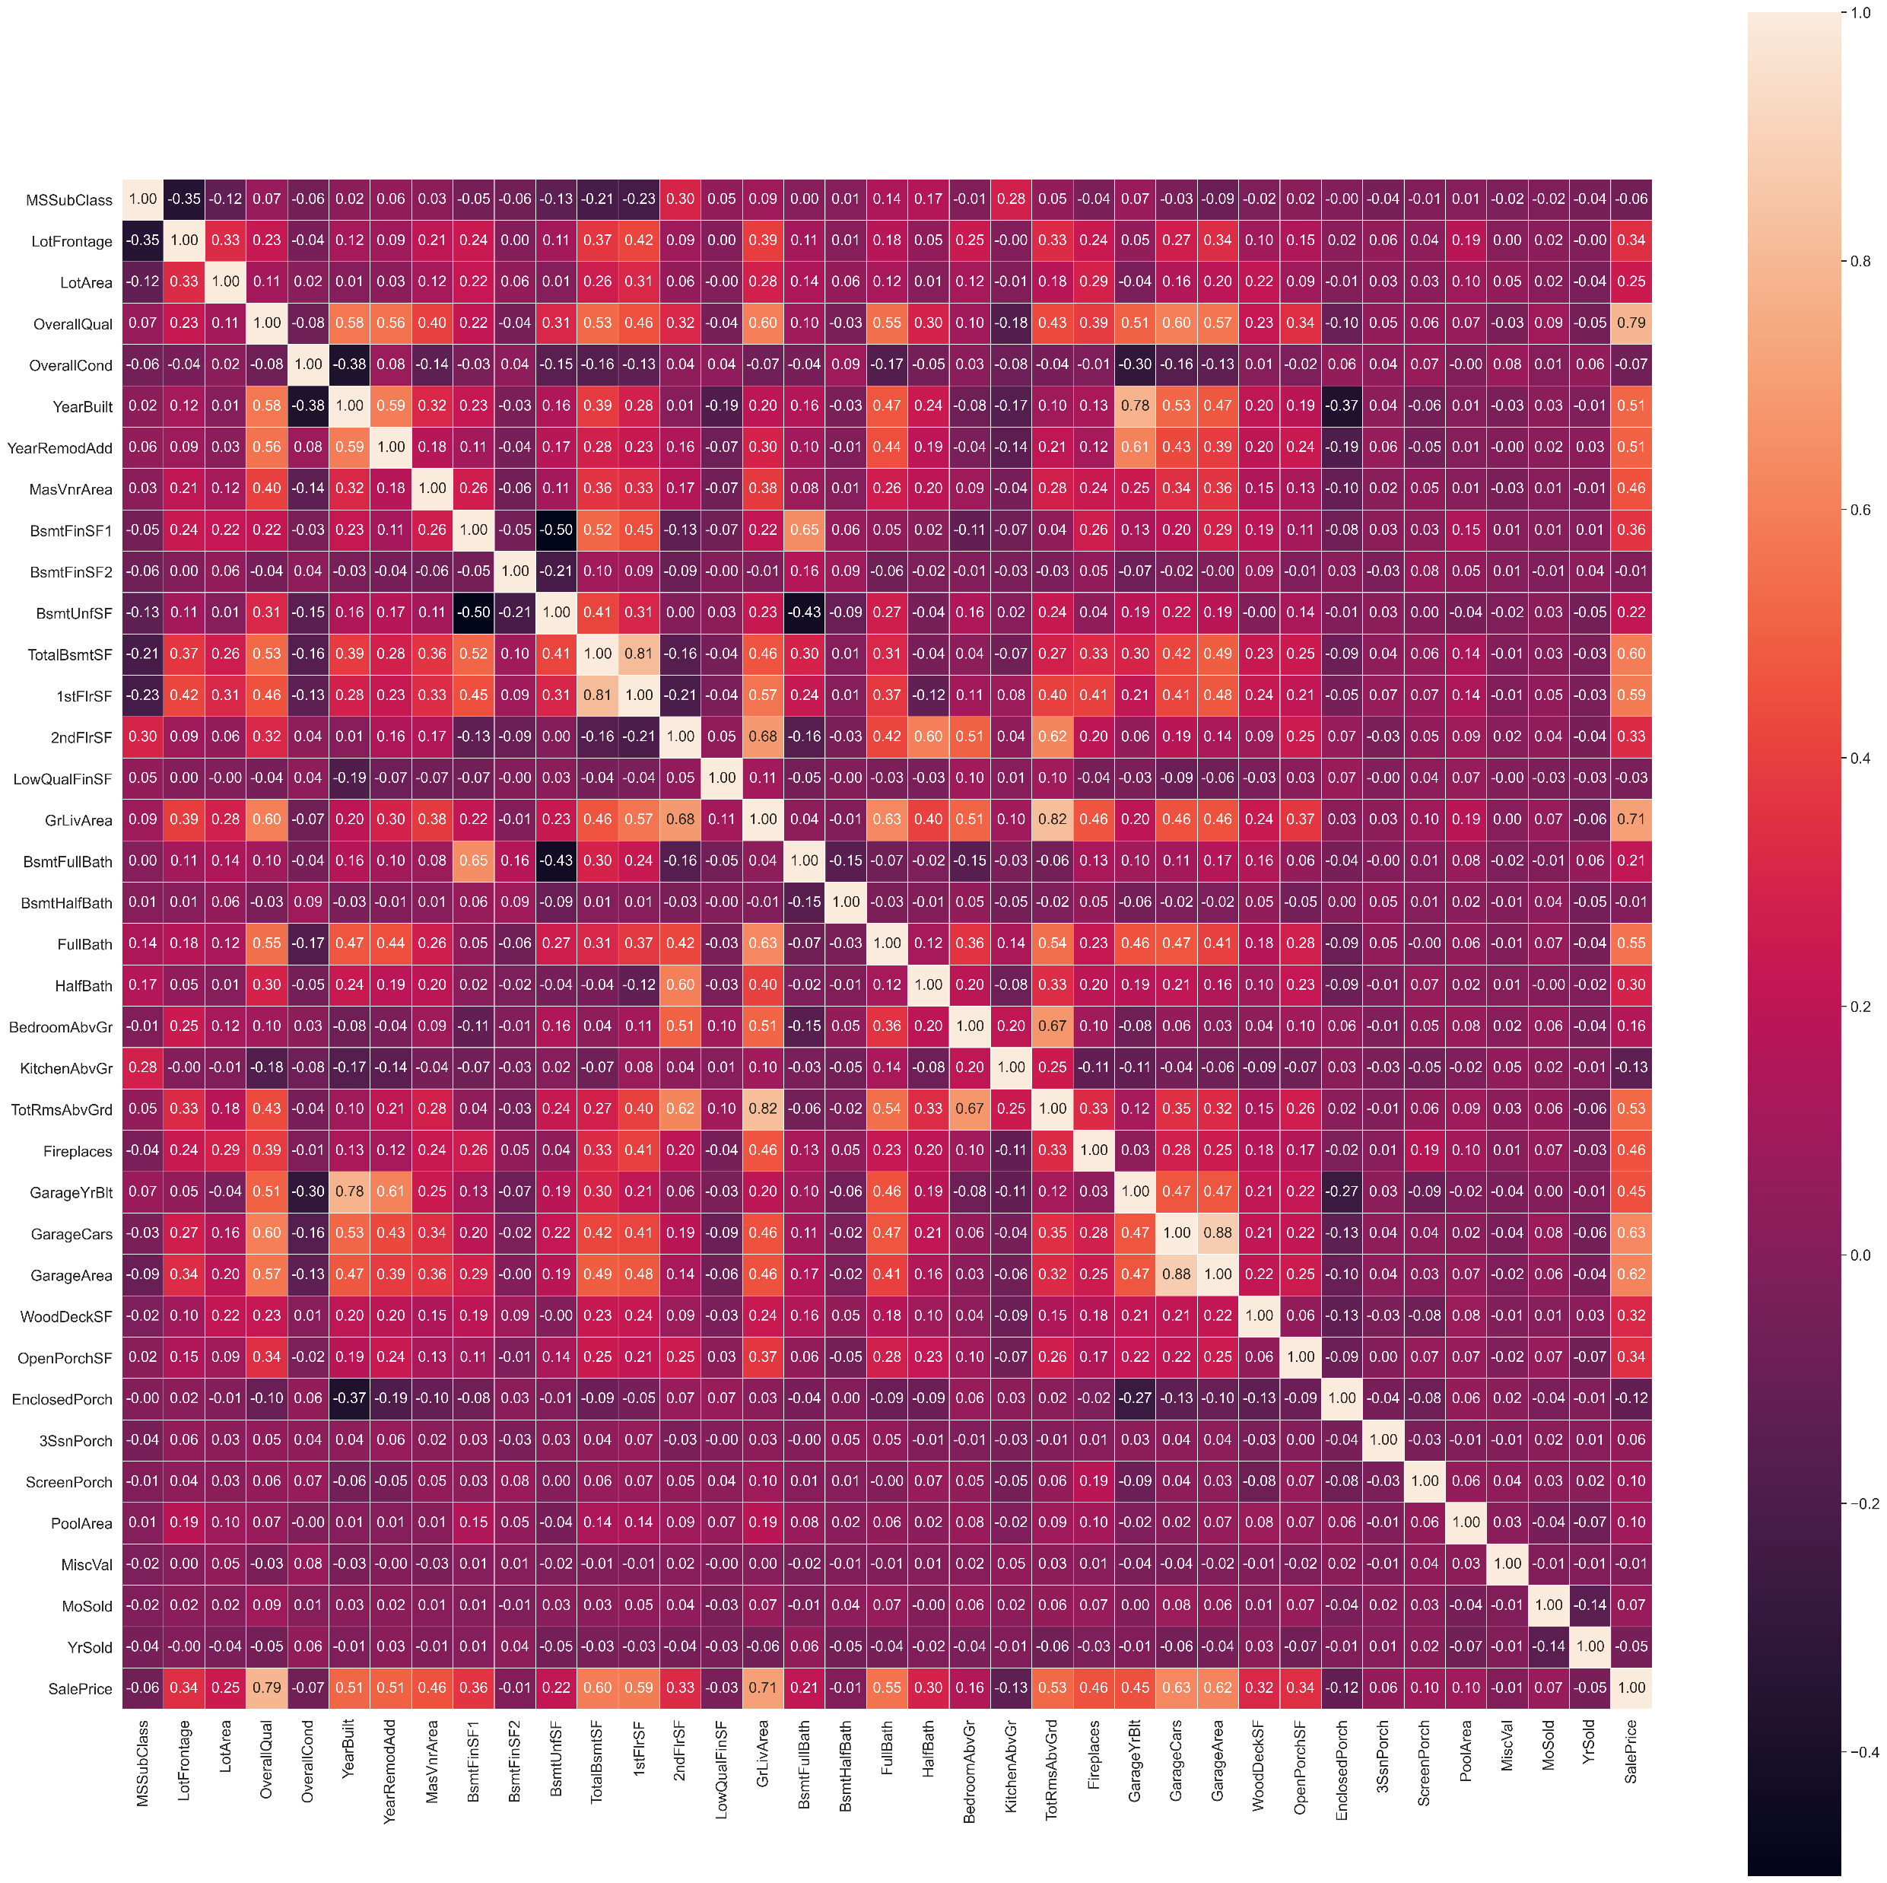
Graphical Analysis.

Slide 8
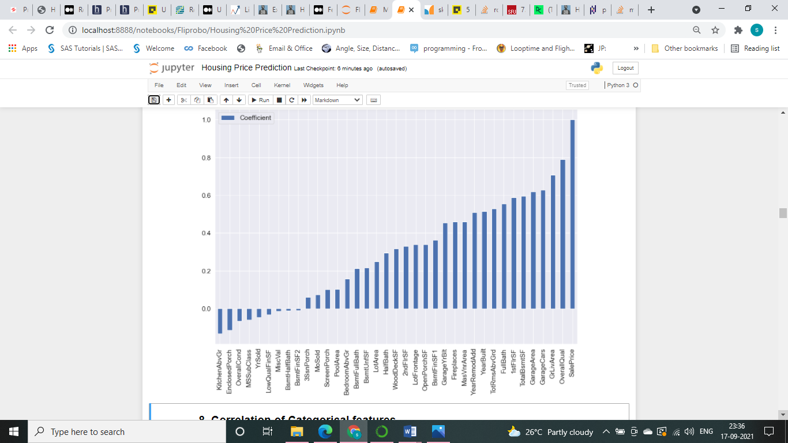
Finding Important Features for Model
We have identified important Numeric and Categorical Feature for Model through Anova Technique.
Important Numerical Features:

Slide 9
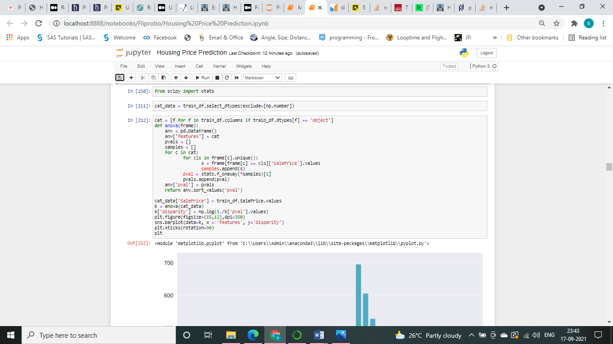
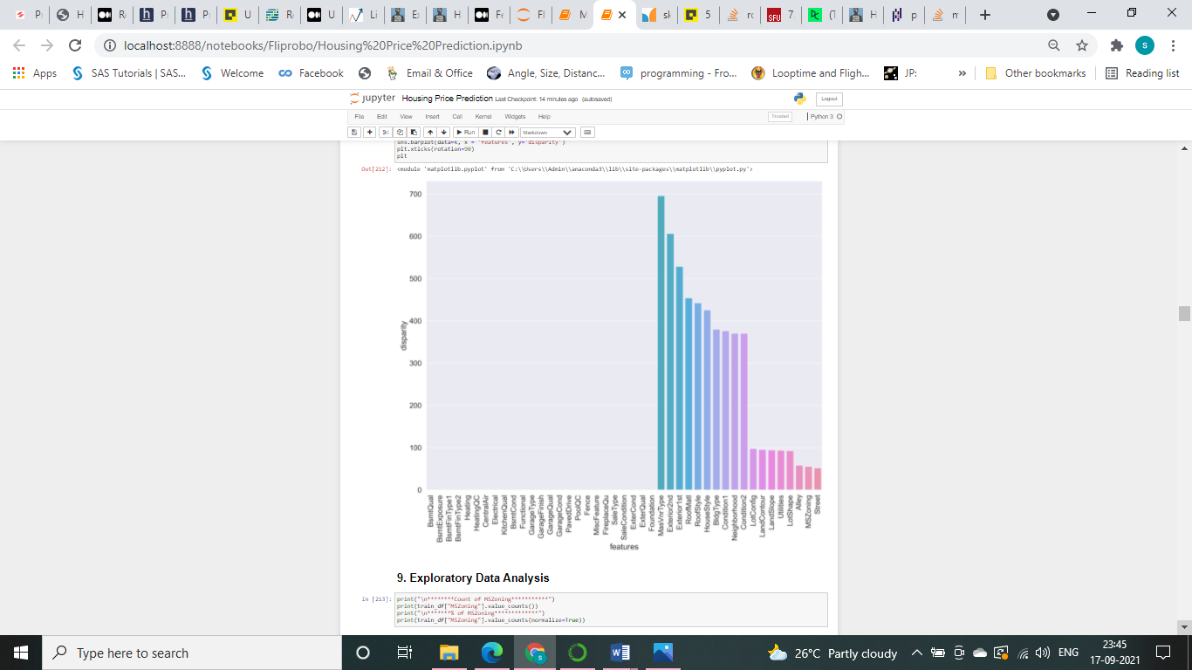
Finding Important Features for Model
Important Categorical Features:

Slide 10
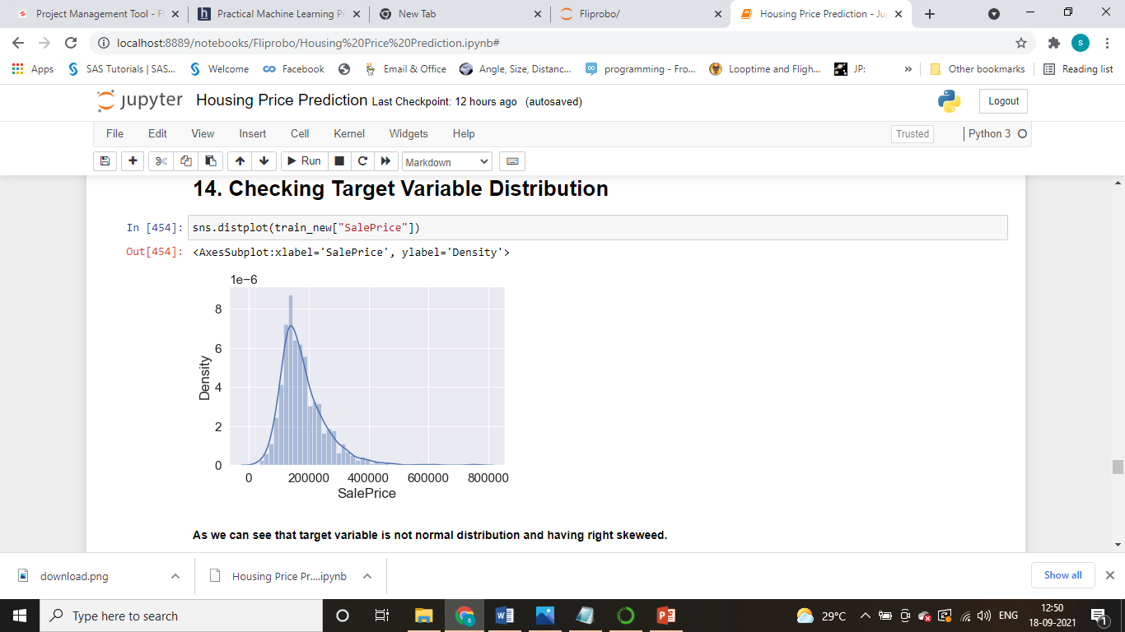
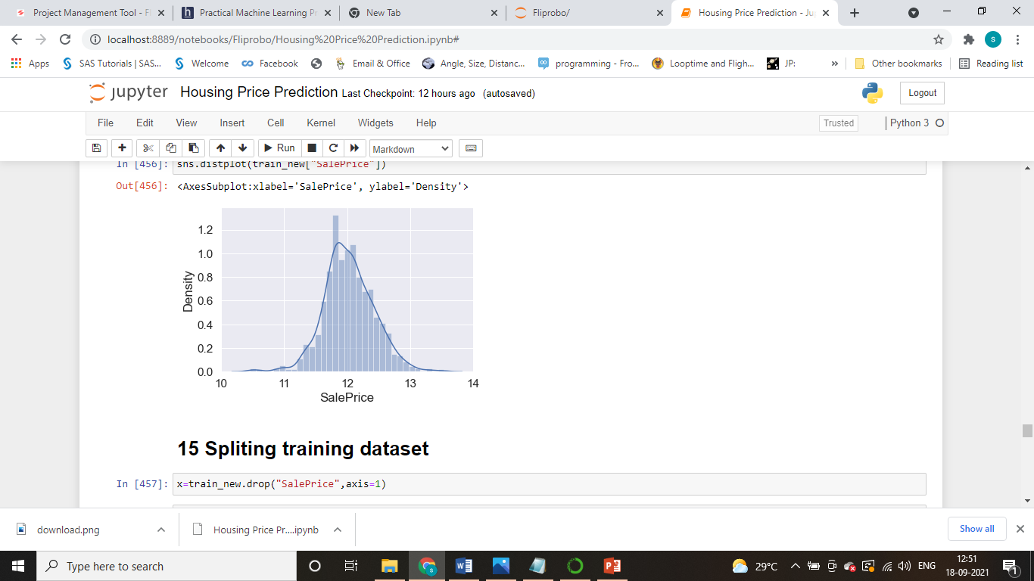
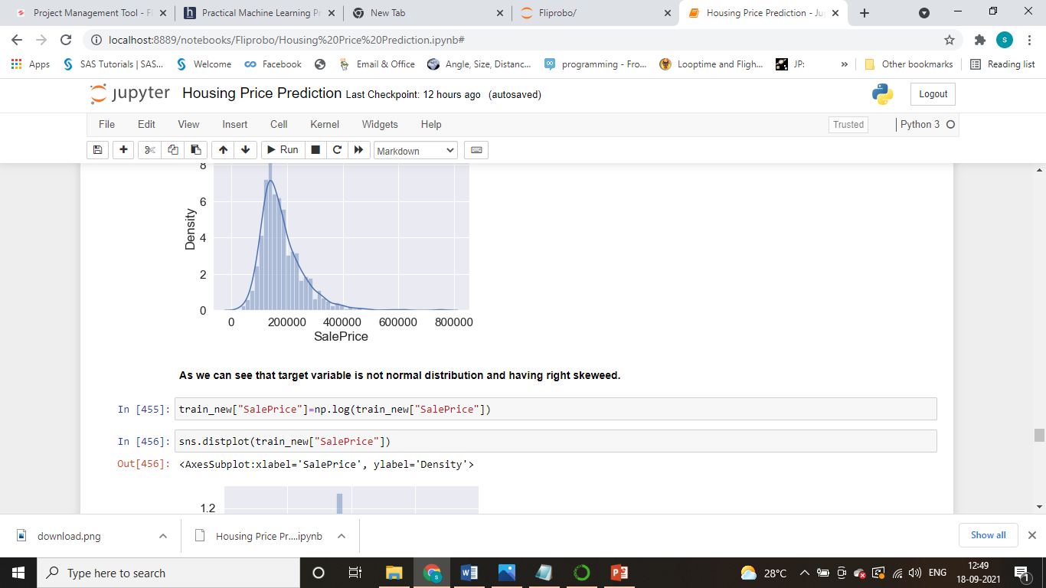
Dealing with Skewed Target Variable
Before Log Transform:
After Log Transform:

Slide 11
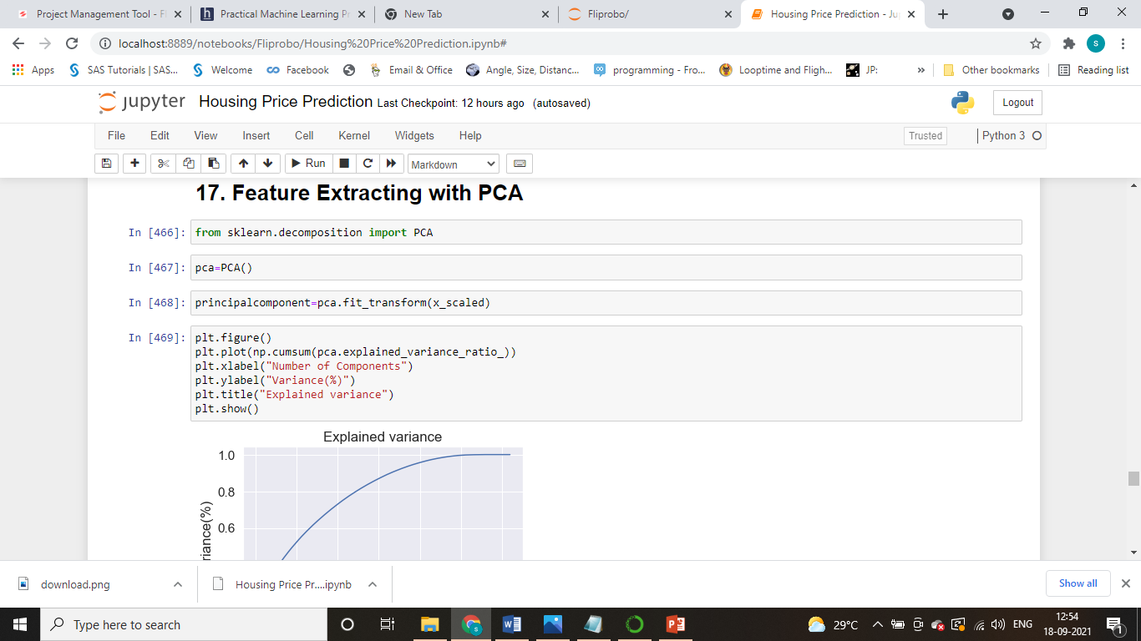
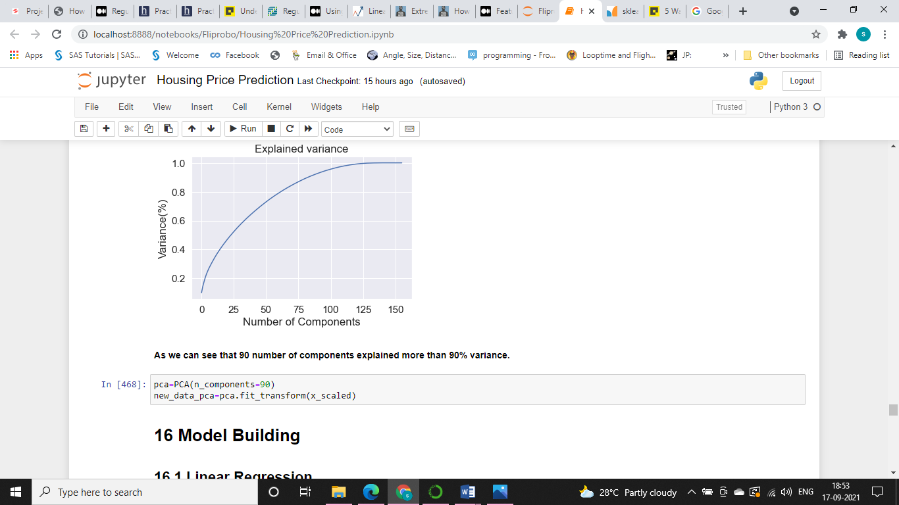
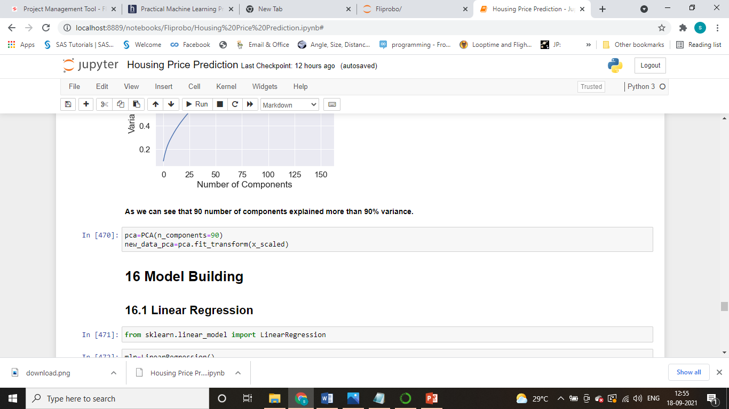
Principal Components Analysis

Slide 12
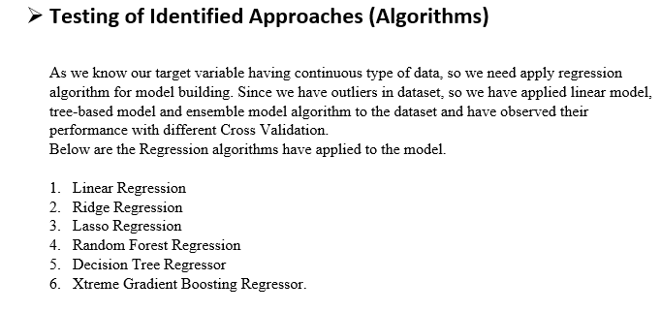
Model Development

Slide 13
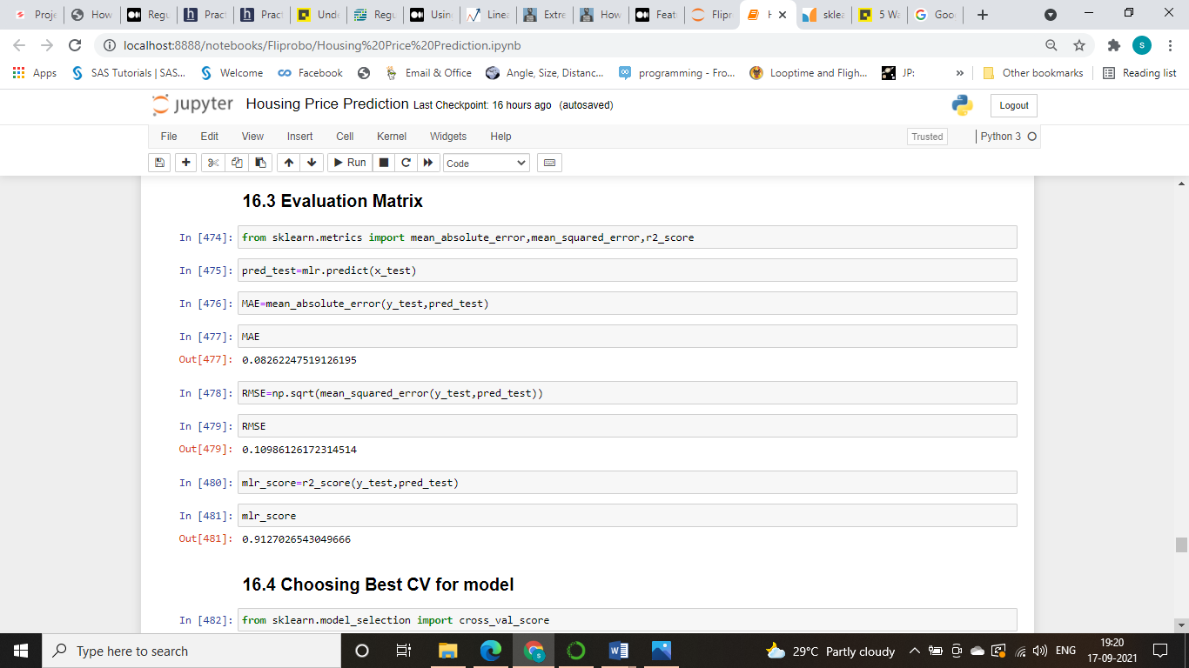
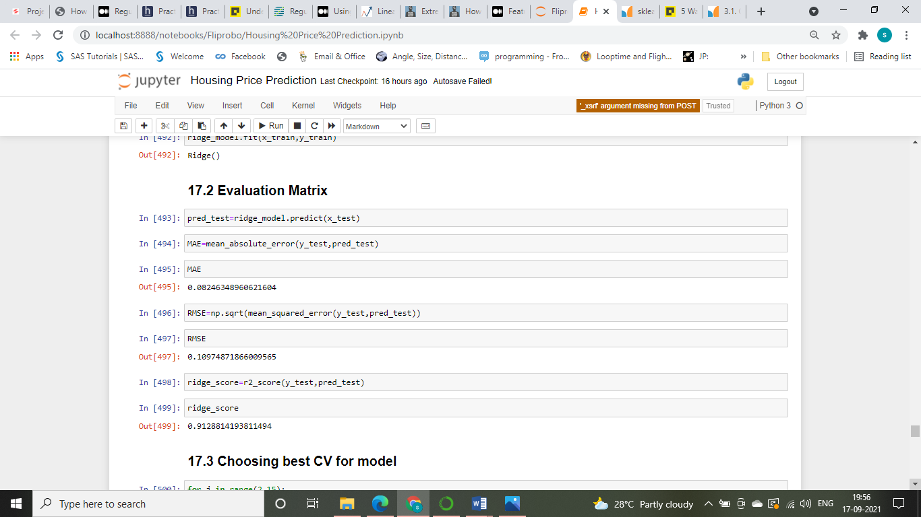
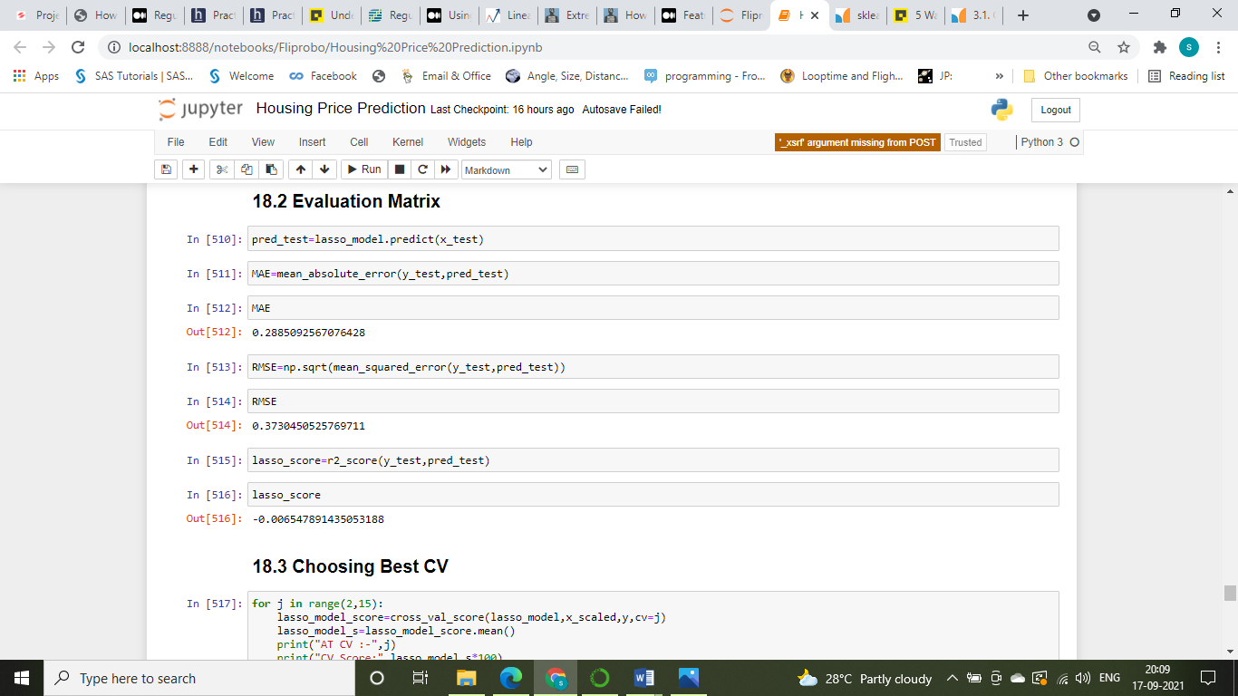
Model Evaluation
Linear Regression
Ridge Regression
Lasso Regression

Slide 14
Model Evaluation
We have evaluated model with R2 Score, Cross Validation Score and MAE error
Linear Regression
Ridge Regression
Lasso Regression

Slide 15
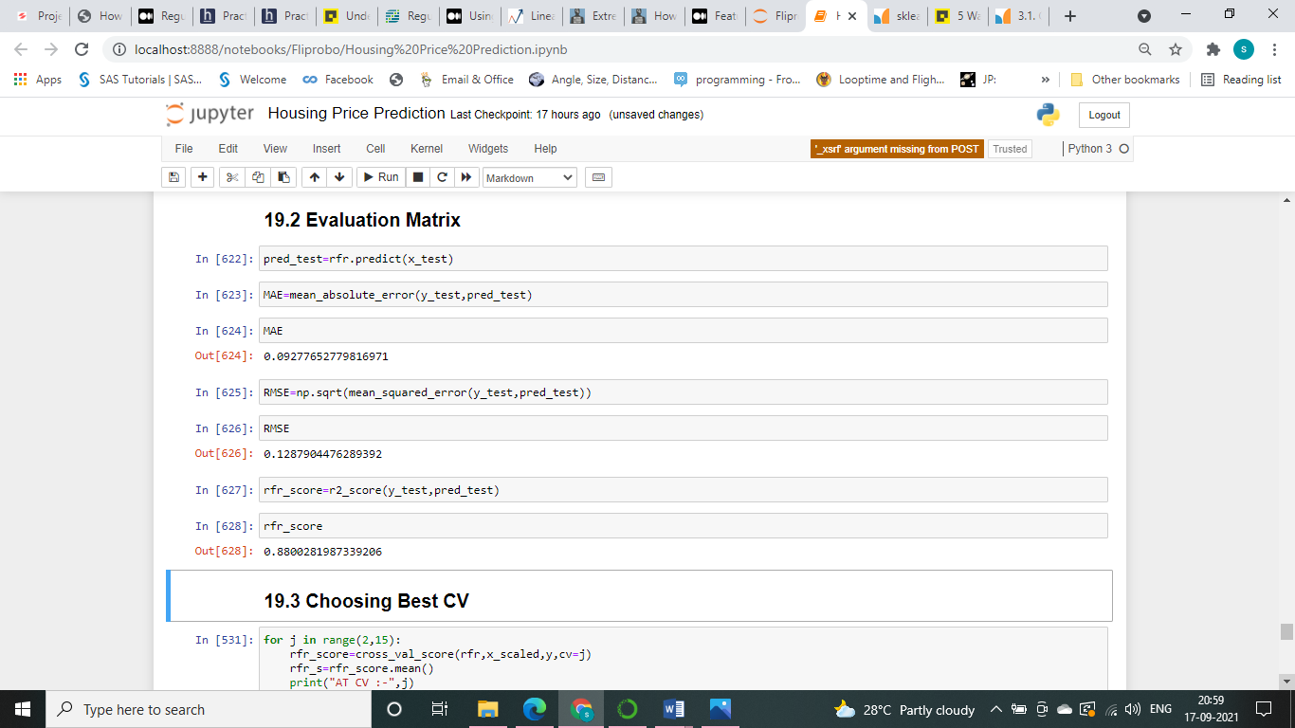
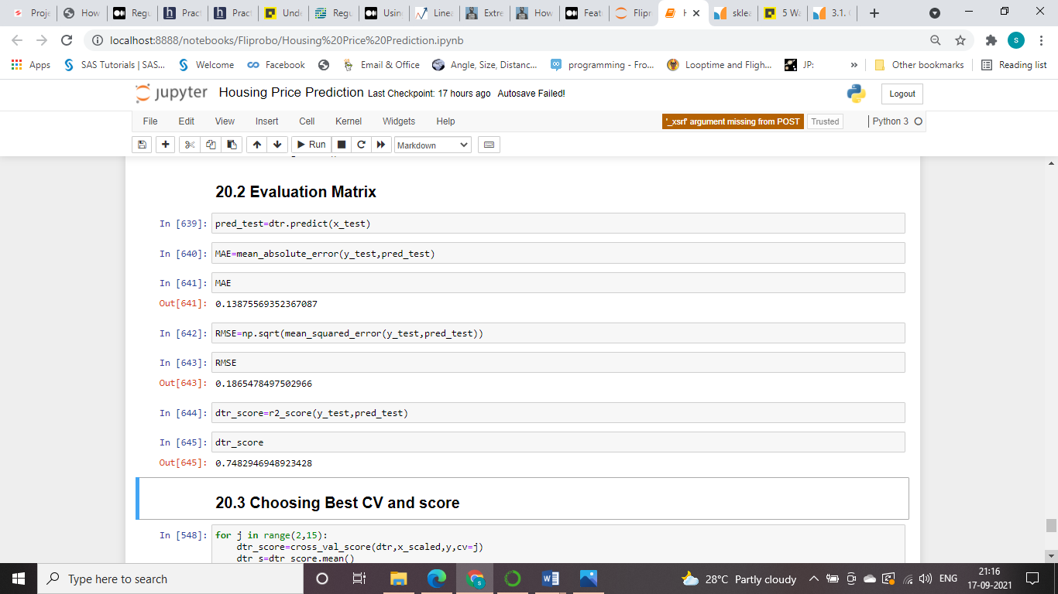
Model Evaluation
We have evaluated model with R2 Score, Cross Validation Score and MAE error
Random Forest Regressor
Decision Tree Regressor

Slide 16
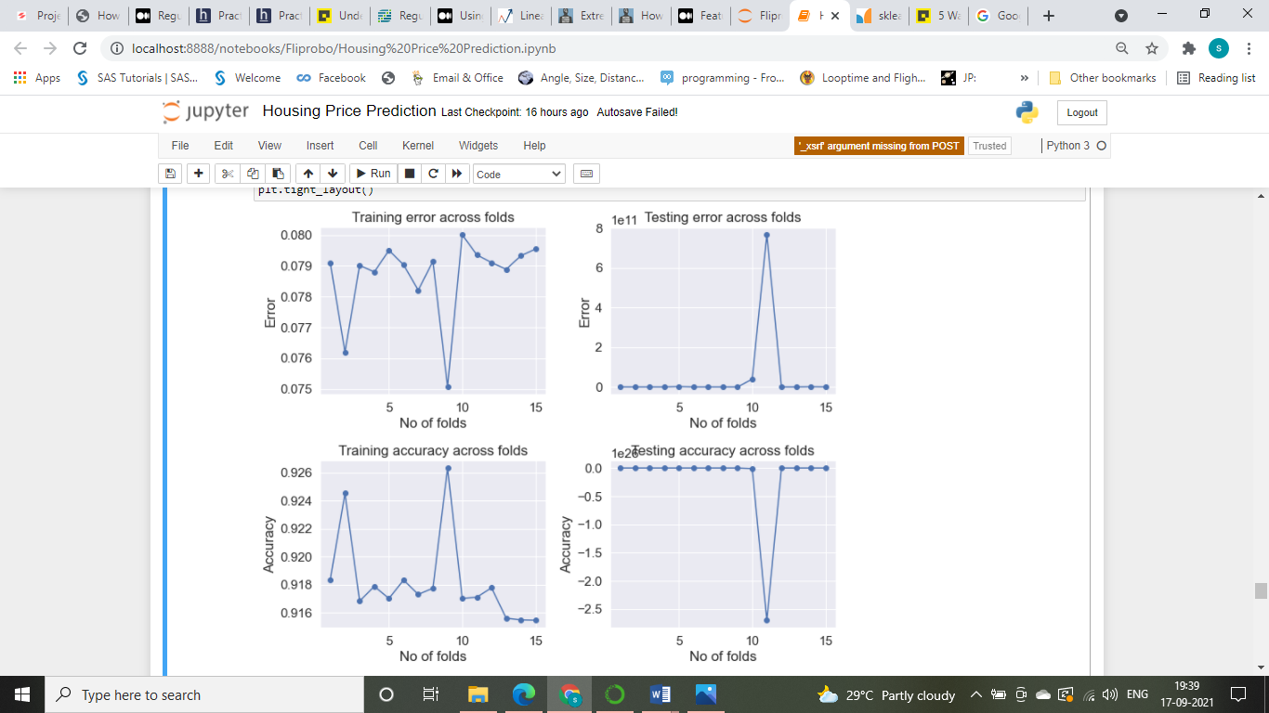
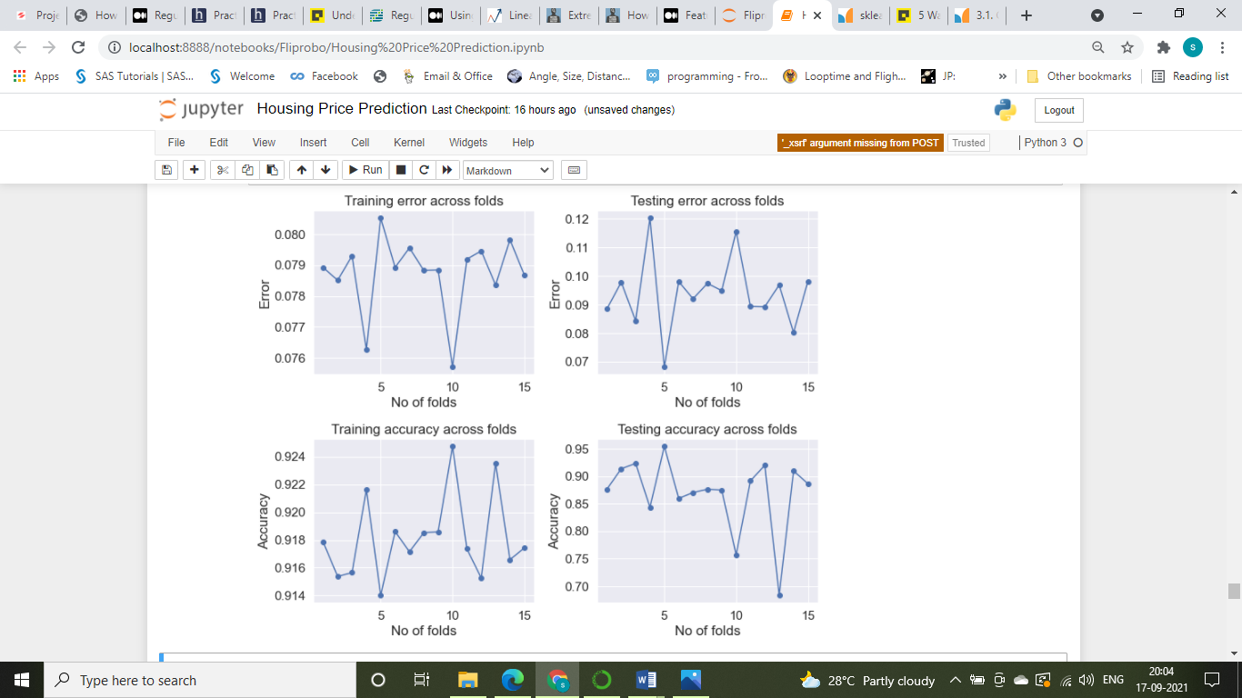
Checking Overfitting & Underfitting Problem
Linear Regression
Ridge Regression

Slide 17
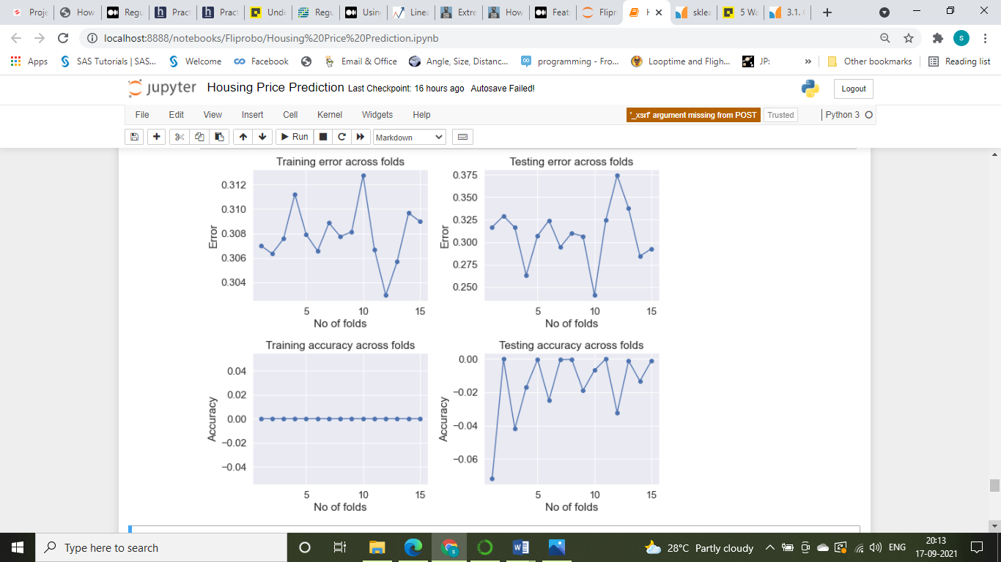
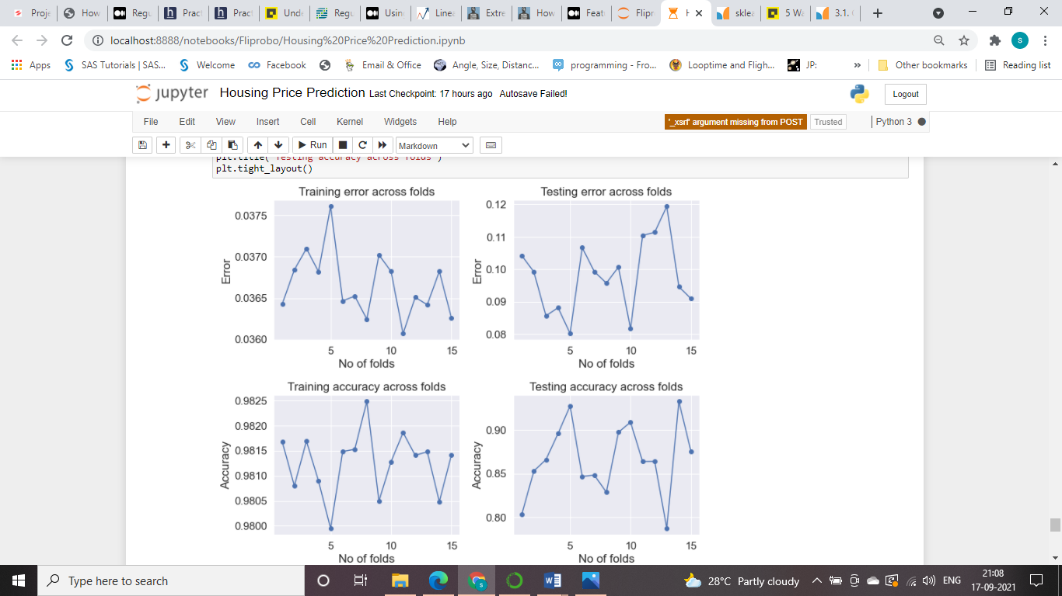
Checking Overfitting & Underfitting Problem
Lasso Regression
Random Forest Regressor

Slide 18
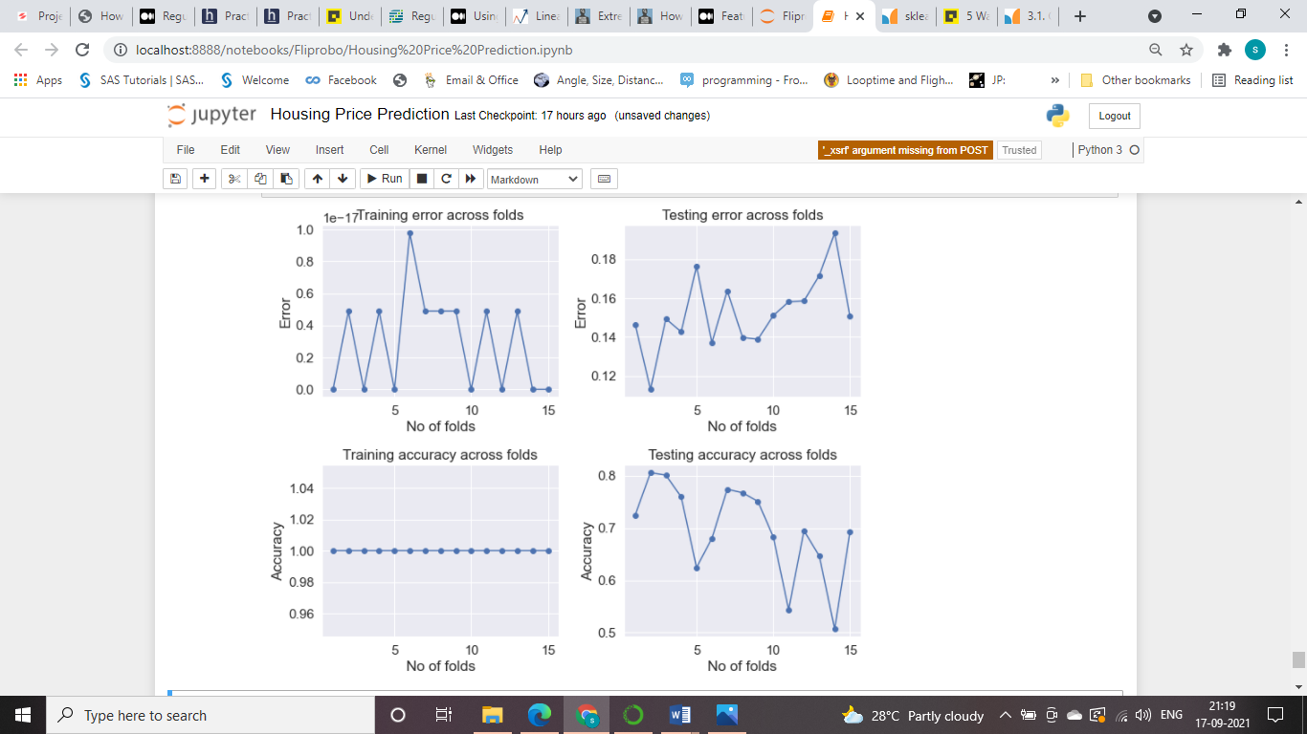
Checking Overfitting & Underfitting Problem
Decision Tree Regressor

Slide 19
Conclusion
We have shown in Fig, Ridge Regression is performing better compared to Linear Regression, Lasso Regression, Random Forest Regressor, Decision Tree Regressor.

Slide 20
Conclusion
While doing Principal Components Analysis, as shown in Fig , we can go with 90 number of components to get more than 90% of variance explained, but we have tried the model performance without PCA applied in model.
While doing visual analysis and under EDA we have got like the some of the most important feature for prediction of housing price are OverallQual, GrLivArea, GarageCars, GarageArea, TotalBsmtSF, 1stFlrSF, Full Bath, TotalRmsAbvGrd, MasVnrType, Exterior2nd, Exterior1st, RoofMatl, RoofStyle, HouseStyle, BldgType.
We have Confirmed that based on R2 Score, CV Score and MAE error Ridge Regression Model is performing better.
We have seen other model R2 Score also is good like Linear Regression, Random Forest Regressor but have seen that model having Overfitting issue So we have done the Regularization with Ridge Regression.

Slide 21
THANK YOU

